Slide 1
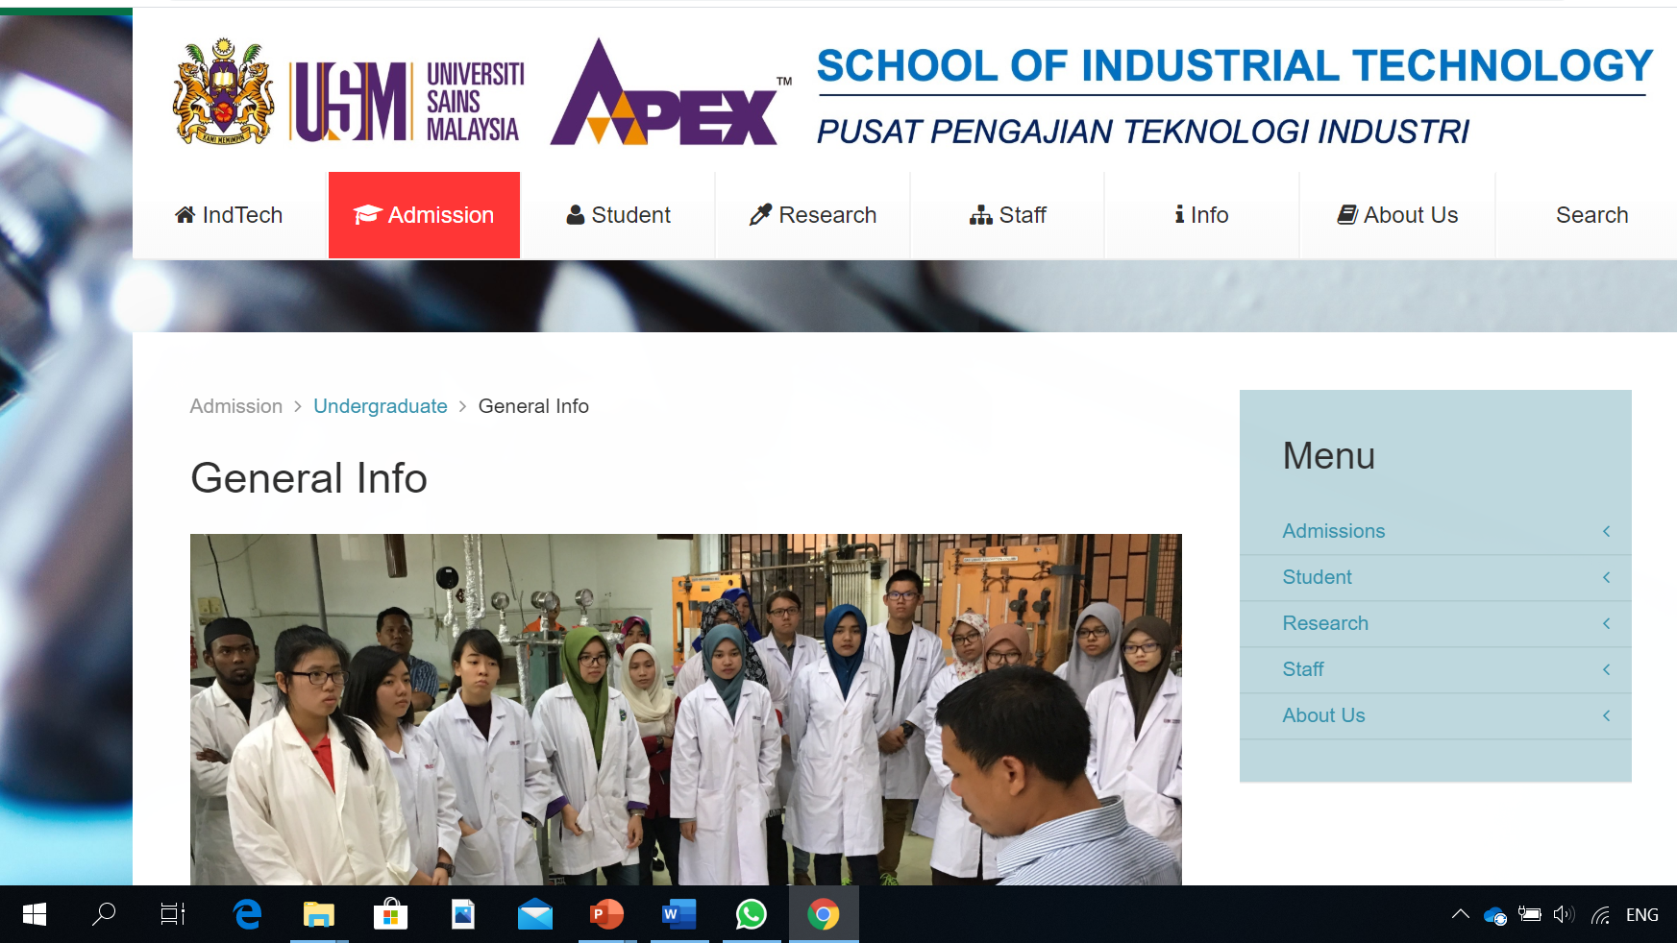
Our Academic Programmes

Slide 2


Slide 3
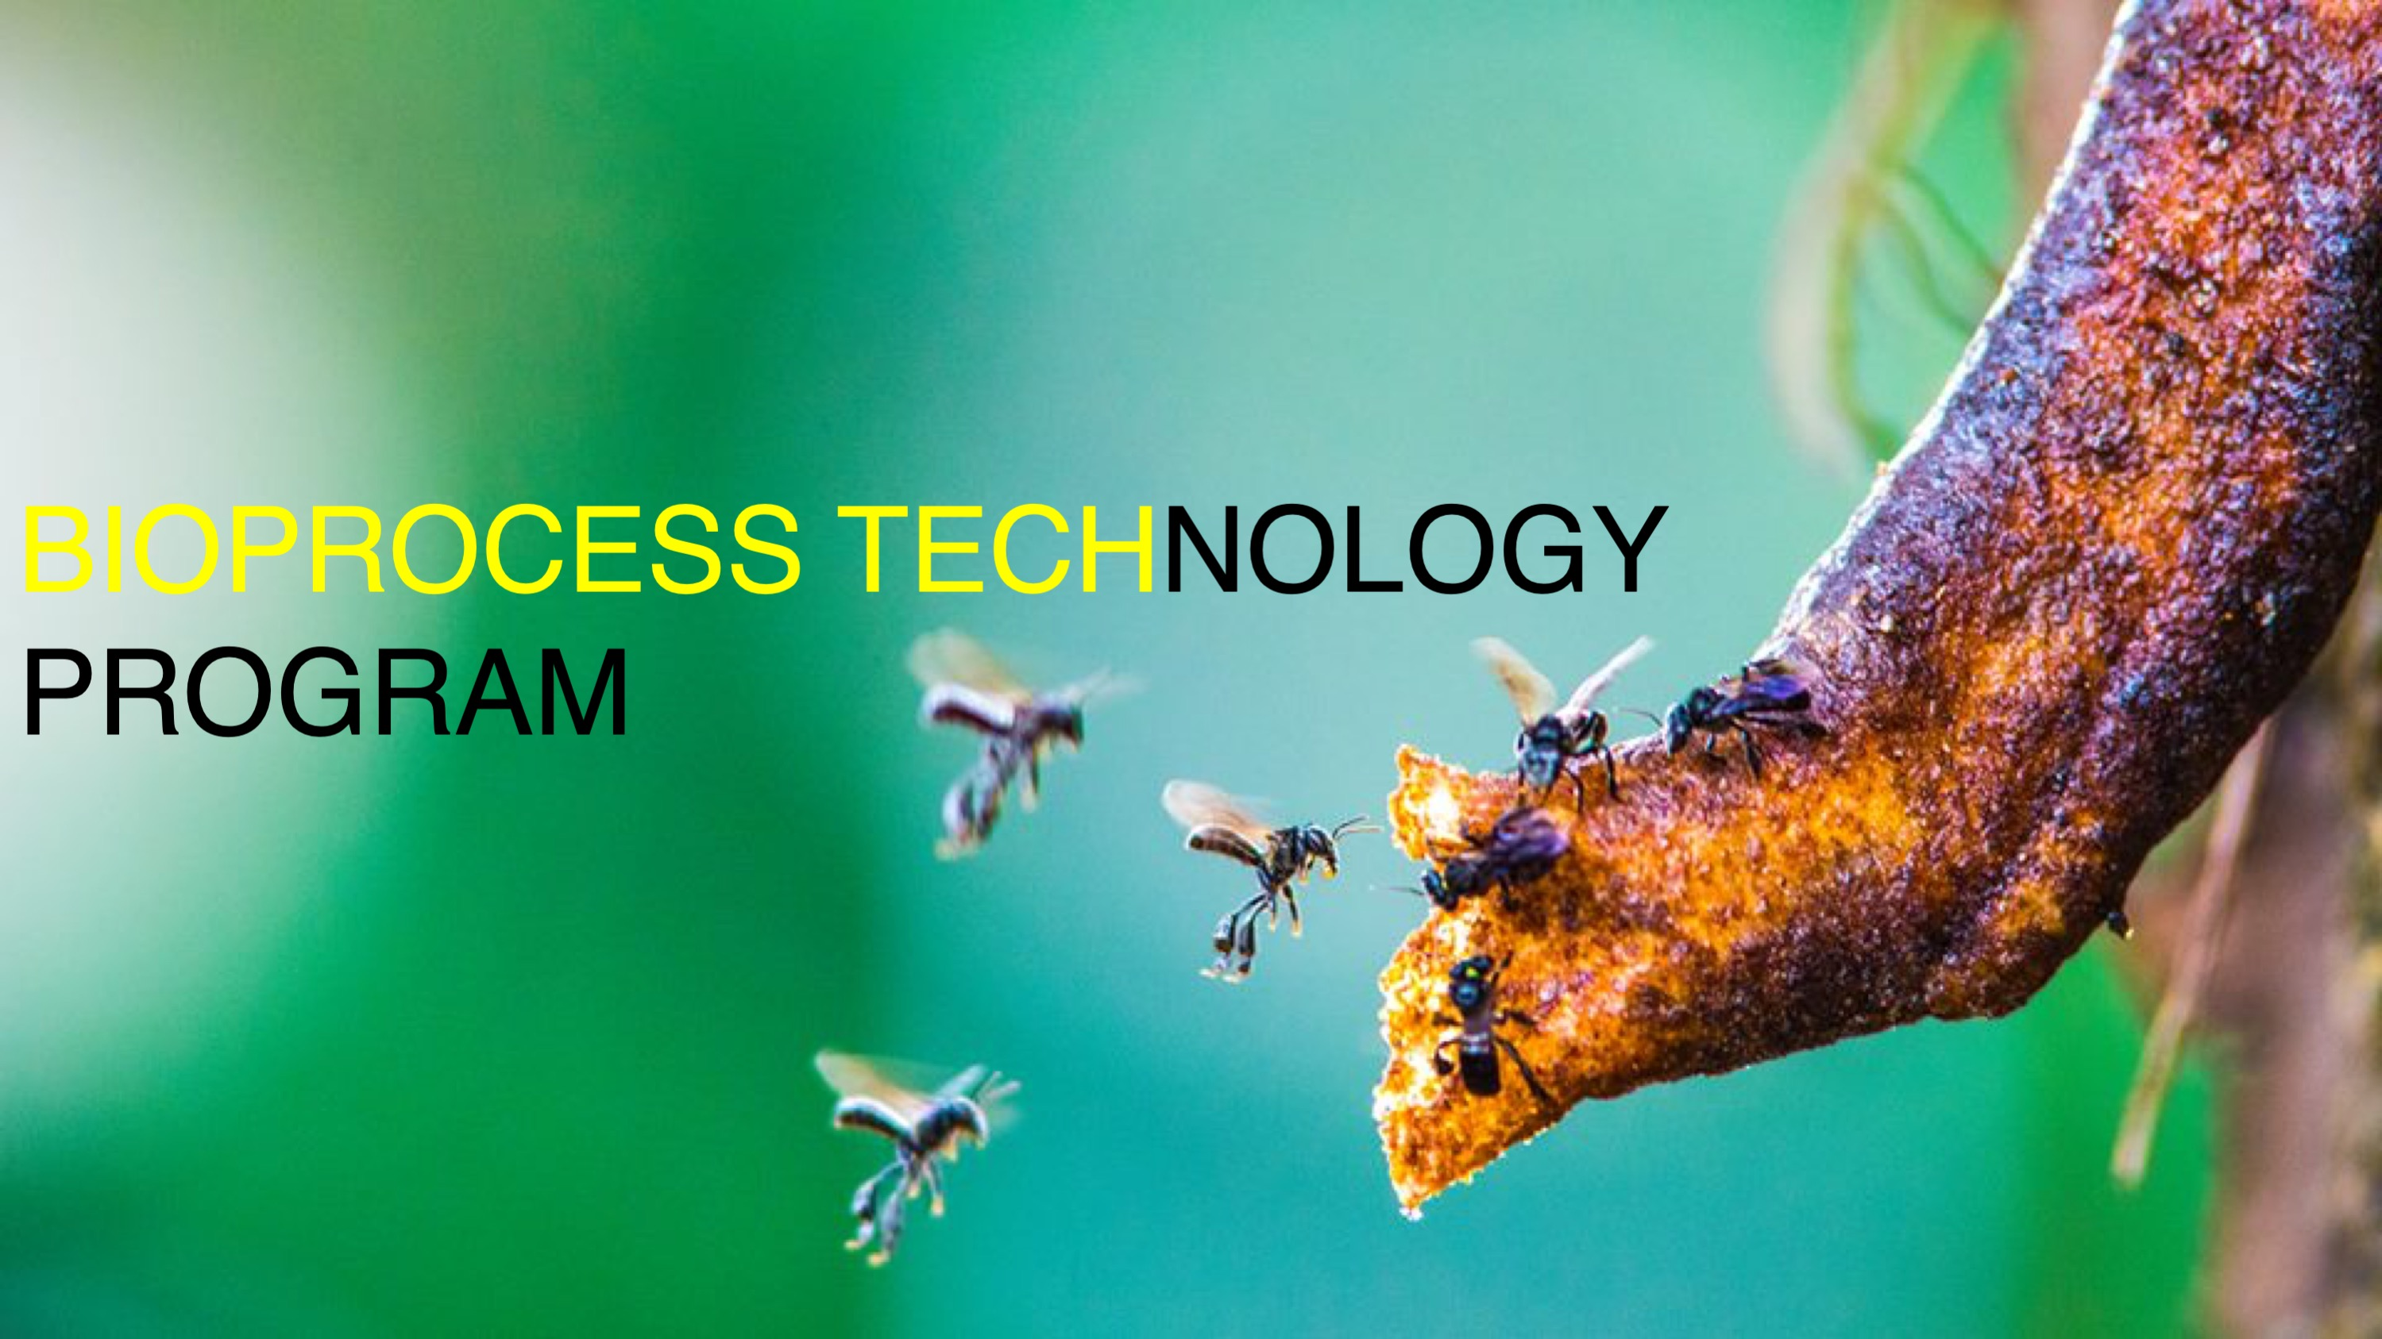

Slide 4


Slide 5

BIORESOURCE TECHNOLOGY

Slide 6
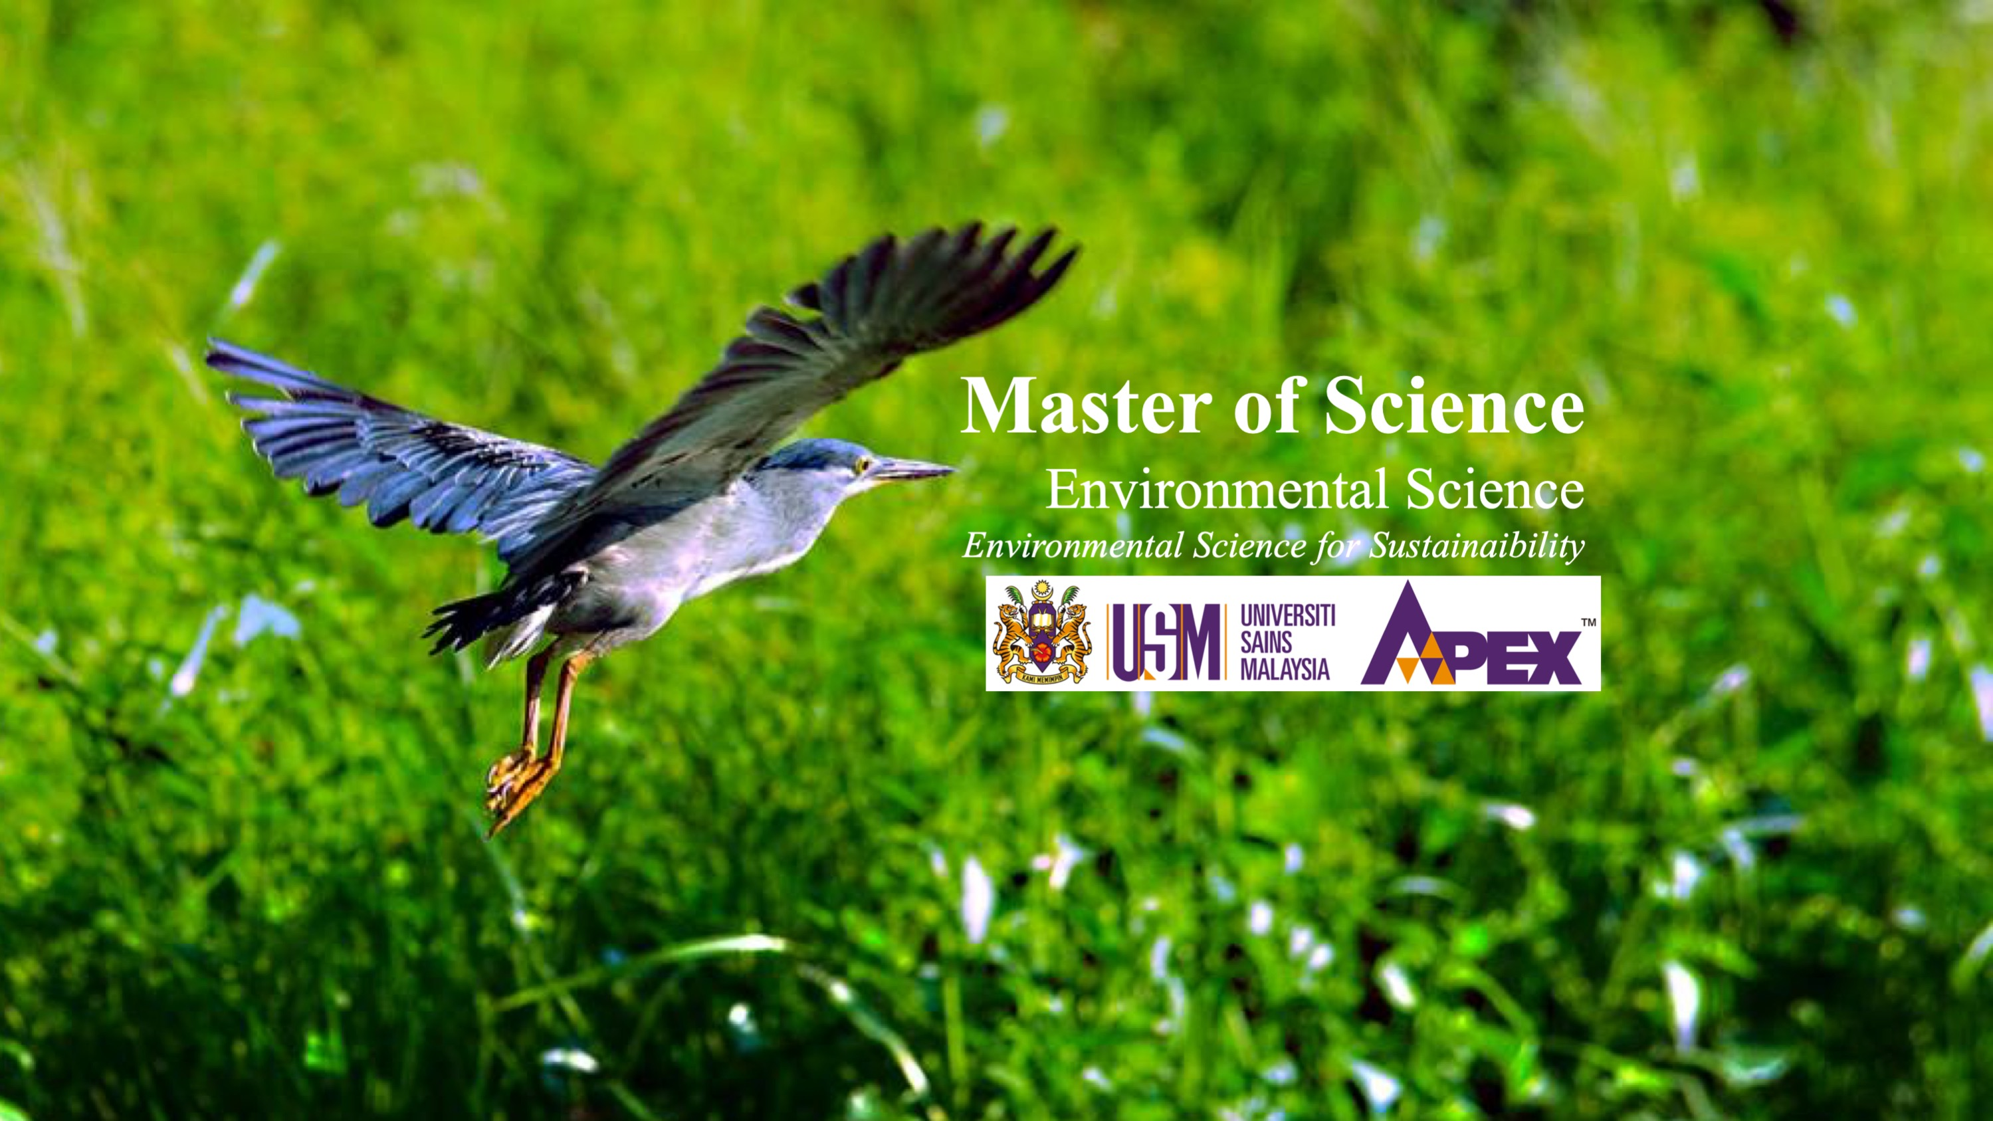

Slide 7
